Slide 1
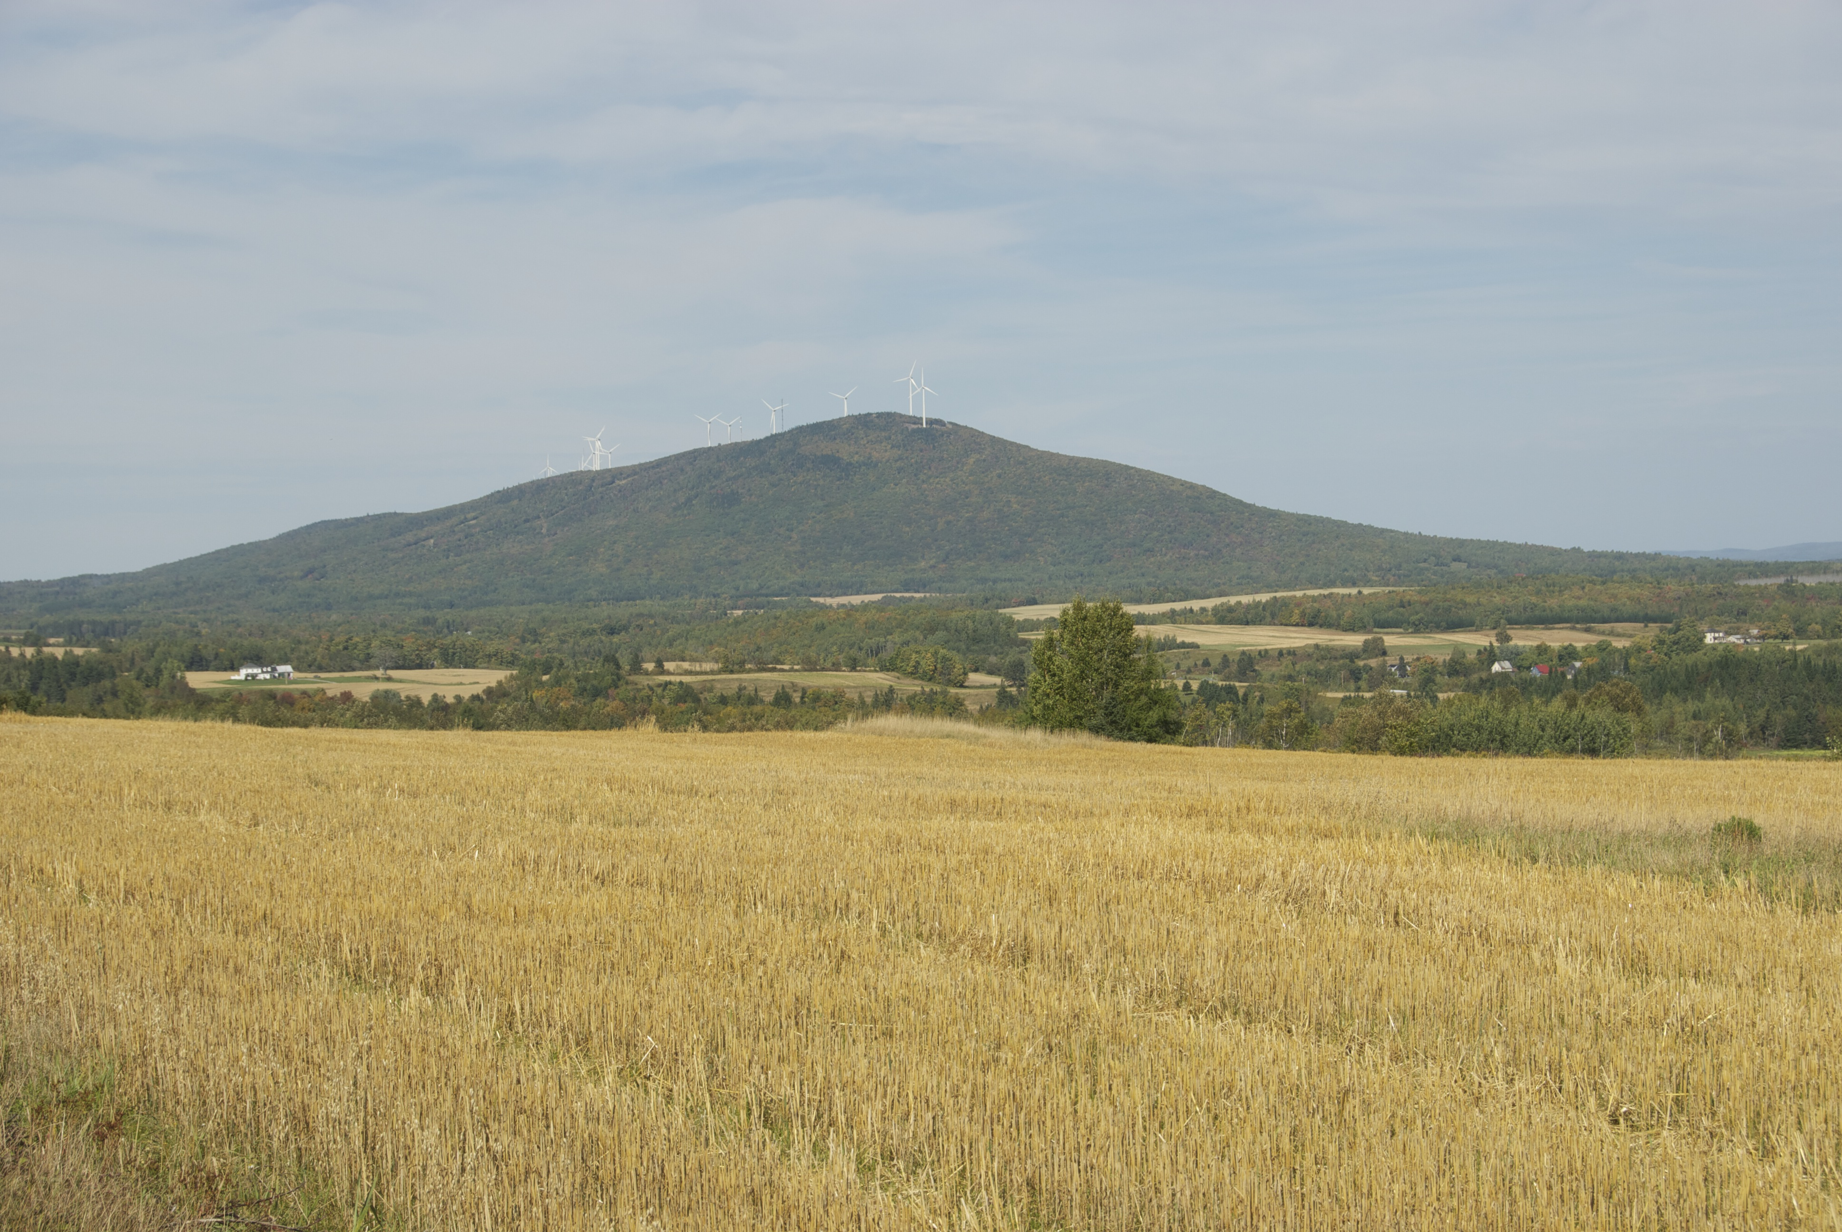
Wind Power and the Maine Economy
Charles S. Colgan
Professor of Public Policy & Management
Muskie School of Public Service
University of Southern Maine

Slide 2
Impacts v. Benefits
Impacts: Changes in the levels of economic activity in Maine
  Employment
  Economic Output
  Wages
Benefits
  Reductions in price
  Increases in reliability
  Changes in environmental values

Slide 3
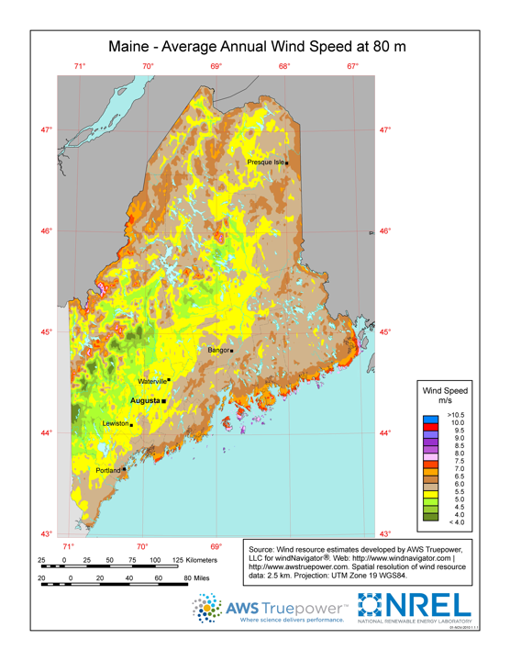


Projects Examined:
257 MW
Trans Canada
Kibby Project
132 MW
First Wind
Mars Hill
42 MW
First Wind Stetson I and II
83 MW

Slide 4
Construction Period Expenditure Profile
 | Total
Construction | $197.82
Food & Lodging | $1.31
Professional & Technical Services | $23.67
Total | $222.79

Slide 5
Employment Profile

Slide 6
Employment in the Project Regions

Slide 7
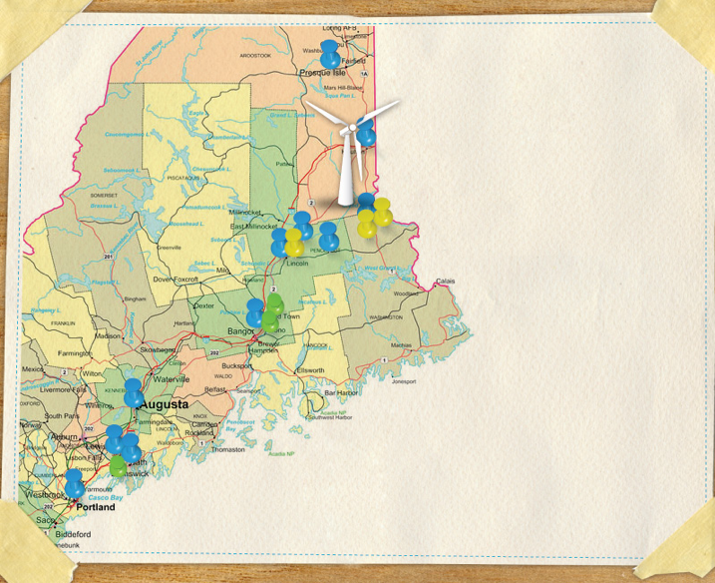
WIDESPREAD IMPACTS

Slide 8
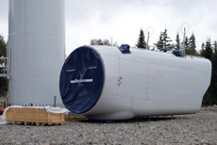
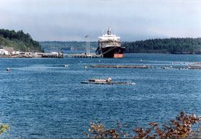
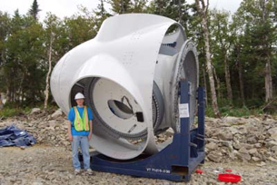
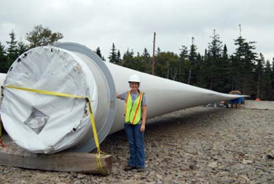
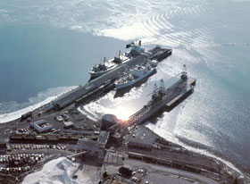
Excluded from the Impact Analysis
Eastport
Searsport

Slide 9
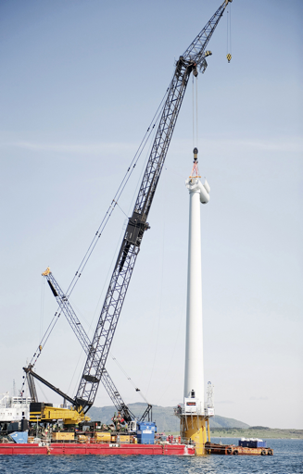
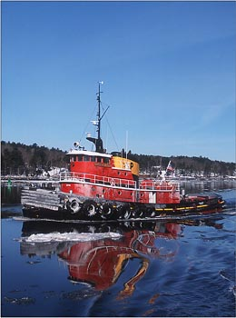
Offshore:
Similar to Onshore with Marine Component

Slide 10
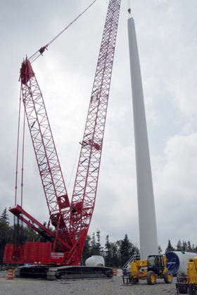
Operating Period EMPLOYMENT
Routine Operations & Maintenance
~30 Direct
15 Indirect
Total ~45

Slide 11
“Jobs”
Jobs “created”
  Construction
    “Full time”?
Jobs “supported”
  Professional & Technical
  Restaurant & Lodging
  Indirect Jobs

Slide 12
Taxes
Taxes are transfers: they are neither costs nor benefits in determining the ultimate economic value of an investment
Modest gains in state taxes
Property taxes of large energy projects in small communities
  Large increases in valuation
    Decreases in tax rates
    Increases in local services

Slide 13
Costs and Benefits
Costs:
  Project expenditures in construction and operating period
  Reductions in wild land values
Benefits
  Price reductions
  Reliability credits
  Avoided environmental costs

Slide 14






